Slide 1
Computer Graphics (L06) EG678EX
2-D Algorithms

Slide 2
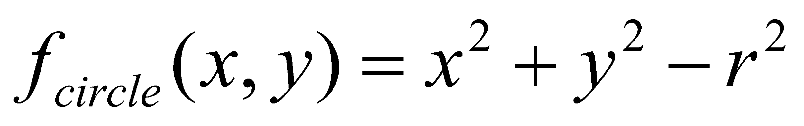
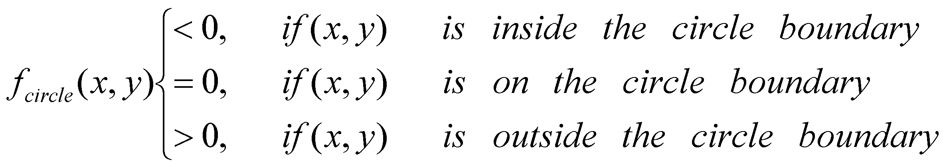
Midpoint Circle Algorithm
Circle function defined as:
Any point (x,y) satisfies following conditions

Slide 3
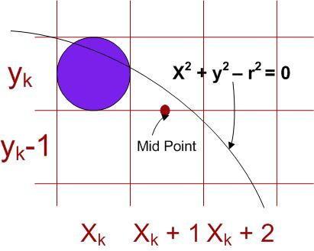
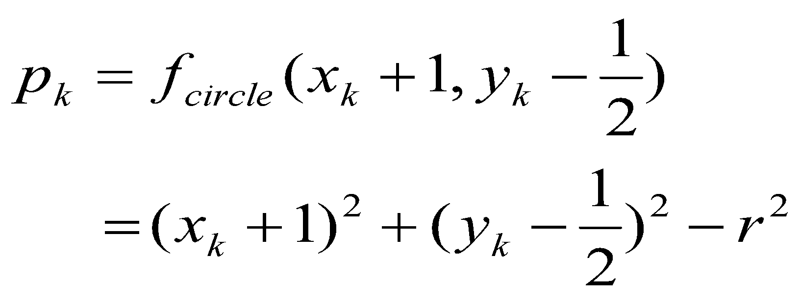
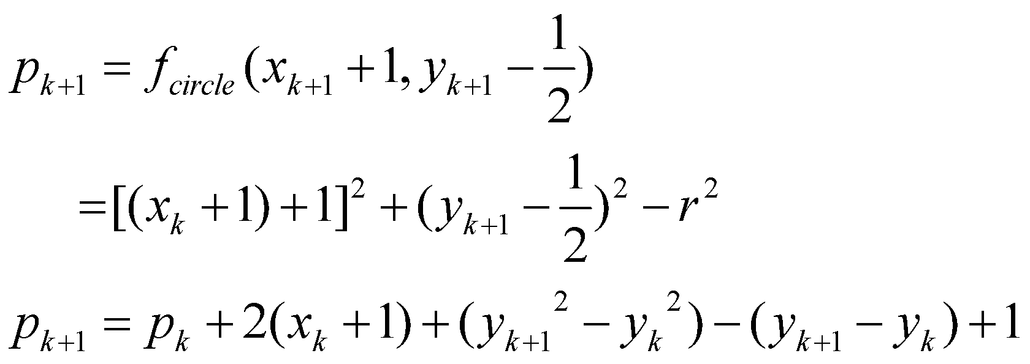
Decision parameter is the circle function; evaluated as:

Slide 4
y_{k+1} = y_{k} if p_{k}<0
y_{k+1} = y_{k}-1 otherwise
Thus
P_{k+1} = P_{k} + 2x_{k+1}+1 if pk<0
P_{k+1} = P_{k} + 2x_{k+1}+1-2y_{k+1} otherwise
Also incremental evaluation of 2x_{k+1} and 2y_{k+1}
2x_{k+1} = 2x_{k} + 2
2y_{k+1} = 2y_{k} – 2 if p_{k} >0
At start position (x₀,y₀) = (0,r)
2x₀ = 0 and 2y₀ = 2r

Slide 5
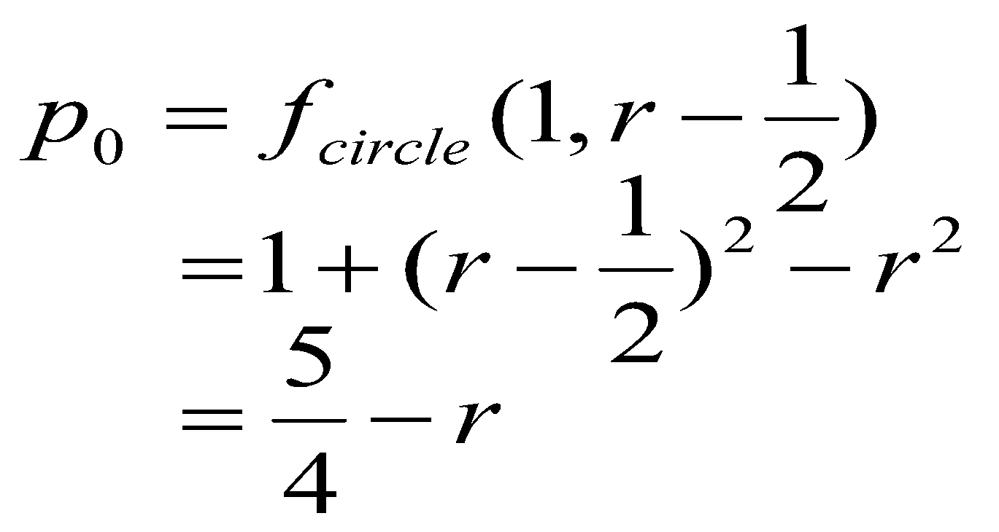
Initial decision parameter
For r specified as an integer, round p₀ to
P₀ = 1-r
(because all increments are integers)

Slide 6
Algorithm
Input radius r and circle center (x_{c}, y_{c}) and obtain the first point on the circumference of a circle centered on the origin as
(x₀,y₀) = (0,r)
Calculate the initial value of the decision parameter as
P₀ = 5/4 – r
At each x_{k} position, starting at k = 0, perform the following test:
If p_{k} < 0, the next point along the circle centered on (0,0) is (x_{k+1},y_{k}) and
P_{k+1} = p_{k} + 2x_{k+1} + 1
Otherwise, the next point along the circle is (x_{k}+1,y_{K}-1) and
P_{k+1} = p_{k} + 2x_{k+1} + 1 -2y_{k+1}
Where 2x_{k+1} = 2x_{k} + 2 and 2y_{k+1} = 2y_{k}-2
Determine the symmetry points in the other seven octants.
Move each calculated pixel position (x,y) onto the circular path
centered on (x_{c},y_{c}) and plot the co-ordinate values:
x = x + x_{c}, y = y+y_{c}
Repeat steps 3 through 5 until x ≥ y

